Slide 1
Practice-Based Opportunities for Intensive Intervention
August 6, 2020
Faculty Professional Learning Series: Webinar #2
Lindsey Hayes, M.Ed., & Amy Colpo, M.P.P., American Institutes for Research
Tara L. Kaczorowski, Ph.D., Illinois State University

Slide 2
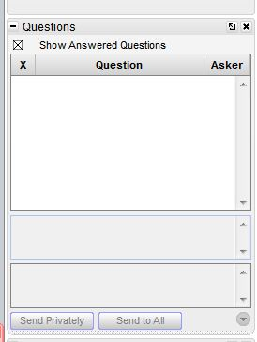
Webinar Format & Questions
Throughout the presentation, submit your questions into the question pod.
  For technical issues/questions, a webinar team member will try to assist you as soon as possible.
  For content related questions, there will be a time for Q&A at the end of the presentation. Submit your questions and we will share them with the presenters.

Slide 3
Faculty Professional Learning Series
Teacher preparation faculty and professional development providers will:
Learn from colleagues and NCII experts about available tools and resources to enhance coursework, field experiences, and professional development opportunities related to intensive intervention.
Share successes, challenges, and lessons learned from the process of enhancing preservice and inservice learning opportunities for educators responsible for delivering intensive intervention.

Slide 4
Agenda
Practice-based opportunities for teacher candidates (30 min)
Video-enhanced performance feedback (15 min)
Q&A (10 min)
Closing (5 min)

Slide 5
Practice-Based Opportunities:
Developing Skills for Intensive Intervention

Slide 6
What Are Practice-Based Opportunities?
High-quality course content
Opportunities to practice teaching and receive feedback
Effective preparation
Opportunities for teacher candidates to integrate content and pedagogy acquired through coursework into instruction.
Source: Benedict, Holdheide, Brownell, & Foley, 2016.

Slide 7
What Do They Look Like?
Field experiences: Observing the practice of others
  Observations
  Interviews
  Shadowing
Clinical experiences: Opportunities for candidates to practice teaching and receive feedback
  Student teaching
  Internships
  Residencies

Slide 8
Importance For Intensive Intervention
Many teachers are underprepared to offer supports and services to students with severe and persistent learning and behavioral challenges.
Complex skills such as designing and delivering intensive intervention must be taught, practiced, and refined during preparation experiences for educators to implement them with the fidelity.
Source: Fuchs, Fuchs, & Vaughn, 2014; Kretlow & Bartholomew, 2010.

Slide 9
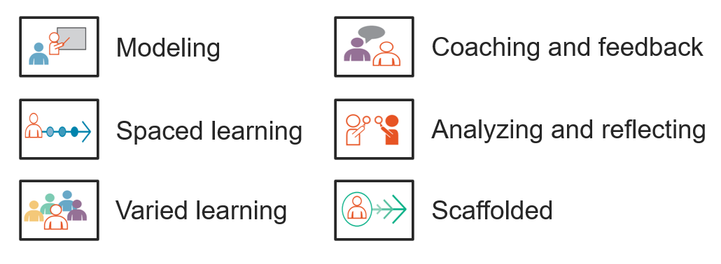
Features of Practice-Based Opportunities
Learning to Teach: Practice-Based Preparation in Teacher Education
Source: Benedict, Holdheide, Brownell, & Foley, 2016.

Slide 10
Meeting the Needs of the Field
Schools and Districts
Stability
Teacher Candidates
Practice
Reflection
Students
Expert instruction
Feedback
Individualization
Support
Guidance
Flexibility
Strong pipeline
Continuity

Slide 11
The Challenge
How can we creatively leverage teacher candidates while providing them with supported, practice-based opportunities?
Special Issues Brief: Addressing Shortages of Educators in an Uncertain COVID-19 Landscape: Viewing Teacher Candidates as Assets
Source: Mason-Williams, Rosenberg, Kimmel, & Sindelar, 2020.

Slide 12
Stages of Candidate Development
Getting Started: Foundational Skills
Gaining Experience: Intermediate Practice
Transitioning from Teacher Candidate to Novice Teacher: Advanced Preparation

Slide 13
Foundational Skills: What It Looks Like
Candidate’s first time visiting in a teacher role
Occurs during introductory coursework
Typically emphasizes observation, but may include activities such as:
  Interviews
  Shadowing
  Review of curricular materials
Short-term, limited duration

Slide 14
Foundational Skills: Getting Started
Candidate Opportunities
Preparation Program Supports
Develop content-focused videos
Require modules on accessibility features
Share ways to evaluate the quality of materials
Evaluate candidate tech expertise
Teach about online security, privacy, and confidentiality
Require mandated reporting requirements earlier
Assist with locating and vetting online materials
Create support materials (scaffolded notes, graphic organizers, etc.)
Monitor small groups (in-person or online)
Post materials to learning management systems

Slide 15
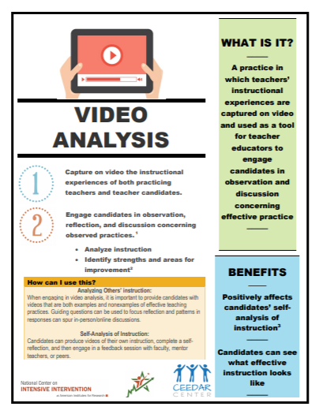
Video Analysis: Observing Others
Video analysis increases opportunities to observe examples (and non-examples) of effective intensive intervention
  IRIS Center Modules
  High-Leverage Practice: Provide Intensive Intervention
  NCII Intensive Intervention Course Content

Slide 16

Intensive Intervention Course Content
Ready-to-use content for faculty and professional development providers!
  Features of Explicit Instruction
  Intensive Intervention in Mathematics
  Intensive Intervention in Reading
  Behavior Support for Intensive Intervention

Slide 17
Intermediate Practice: What It Looks Like
Introductory coursework has been completed and current coursework is focused on methods
Greater expectations for engagement and time in classroom with students
  Multiple days per week or full weeks for a short time
  Teach lessons
  Work with individuals or small groups
  Prepare unit of instruction

Slide 18
Intermediate Practice: Gaining Experience
Candidate Opportunities
Preparation Program Supports
Teach individuals or small groups
Allow hours to be met online or in-person
Targeted skills
Assess gaps
Reteaching/remediation
Create review and extension activities
Provide feedback and oversee online activities
Screening/benchmarking
Assign candidates to a building or team instead of one teacher
Collaborate with districts to meet pressing needs
Conduct supervision activities remotely

Slide 19

Microteaching
Microteaching allows candidates to:
  Plan and teach portions of lessons in front of their peers
  Practice breaking down skills into smaller parts
  Receive feedback and coaching
  Refine their teaching before conducting the lesson with students

Slide 20
Advanced Preparation: What It Looks Like
Typically occurs in the final semester or year
Coursework has been completed
Involves full immersion in the classroom, often with a period of solo teaching
Typically observed multiple times by university personnel
Connected with capstone projects or examinations (e.g., edTPA)
Candidates are expected to demonstrate capability to move into first year of teaching

Slide 21
Advanced Preparation: Transitioning from Teacher Candidate to Novice Teacher
Candidate Opportunities
Preparation Program Supports
Allow candidates to take full responsibility
Discuss family engagement strategies
Assign strong student teachers to cooperating teachers with health concerns
Encourage team and co-teaching
Pair strategically to balance strengths and needs
Promote virtual platforms for mentoring
Reconsider evaluation systems
Allow student teachers to demonstrate skills in unconventional ways

Slide 22
Video Analysis: Self-Observation
Video analysis allows candidates to:
  Reflect on their own teaching
  Connect feedback with specific moments in time
  Receive ongoing coaching and guidance

Slide 23
Delivering Intervention in Virtual Settings:
Video-Enhanced Performance Feedback in Teacher Preparation Clinicals
Dr. Tara Kaczorowski, Illinois State University

Slide 24
Clinical Experiences in Teacher Preparation Programs (1)

Slide 25

Clinical Experiences in Teacher Preparation Programs (2)

Slide 26
Evidence-Based Practices
Evidence-based practices don’t change…
…only the ways we deliver them may change.

Slide 27
Video Recording

Slide 28
Special Considerations

Slide 29
The Opportunity

Slide 30
Video-Enhanced Performance Feedback
Video-Assisted Reflection
Video Analysis
Video-Enhanced Performance Feedback (VPF)
Video Debrief

Slide 31
How Video Enhances REFLECTION
Stable and accessible documentation of teaching performance
Minimizes possibility of faulty memories
Anchors reflections tied to accurate representations
Facilitates more granular reflection

Slide 32

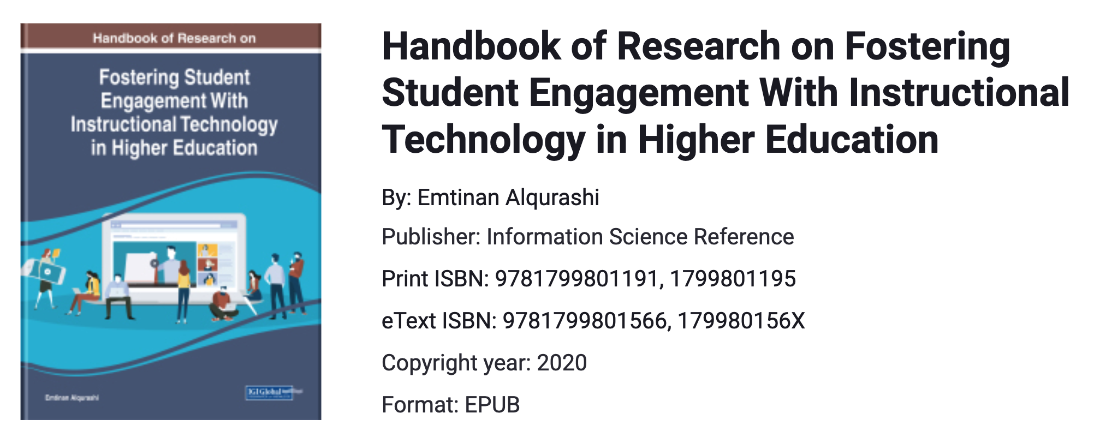
Four Purposes of VPF
To help students notice and evaluate others’ use of specific practices
To promote students’ self-reflection of their own instructional practices
To provide specific feedback for student evaluation
To support instructor self-evaluation.
Co-author, Andrew I. Hashey
SUNY Buffalo State

Slide 33




Examples of Video Platforms

Slide 34
Prioritizing Functions of a VPF Tool: Key Functionality
Annotations linked to video clips, not just paused moments
  Encourage a recursive reflective process (i.e., rewatch segments)
  The instructor sees the exact moment the student selects
Secure platform approved by university
  Amazon Web Services (AWS)
Intuitive and easy to use
Responsive customer support
Customizable “tagging” form
  Match with assignment rubrics

Slide 35
Prioritizing Functions of a VPF Tool: Additional Functionality
Tagging/annotation features
  Two ways of tagging: lead/lag time or toggle button
  Visual timeline of moments to see their relationship to one another
Transcriptions/closed captioning
  AWS auto-transcriptions that are editable and downloadable
Export selected moments into a video reel
Moments with tags/labels to create a hierarchy
  “Meeting Student Needs”
    Strength
    Area for improvement

Slide 36
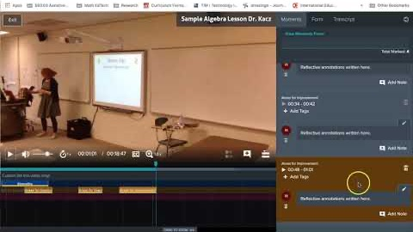
Key Features of Vosaic

Slide 37
Scaffolding Reflection With the STaR Framework
“See it, Try it, and Reflect on it (Switzer, Teuscher, & Siebert, 2015)
See it—Students recognize essential practices in sample teacher videos (e.g., Anita Archer on www.explicitinstruction.org)
Try it—Students self-record their own application of an instructional practice
Reflect on it—Students use video, tags, and annotations to support their reflection

Slide 38
Strategies to Set the Stage for STaR Framework
Provide exemplars of high quality vs. low quality annotations
Select videos with many opportunities to see target skills
Reinforce expectation for both description and evaluation within annotations
Enable candidates to view trends across annotations

Slide 39
Helping Candidates “See it”
Clarify focus through general prompts for candidates:
Annotate each moment of every tag
Identify presence/absence of effective teaching strategies
Support statements by citing relevant supporting research
Flexibility:
Indicate a minimum number of tags to guide students
Feedback within Vosaic:
Address both the focus and quality of the annotations.

Slide 40
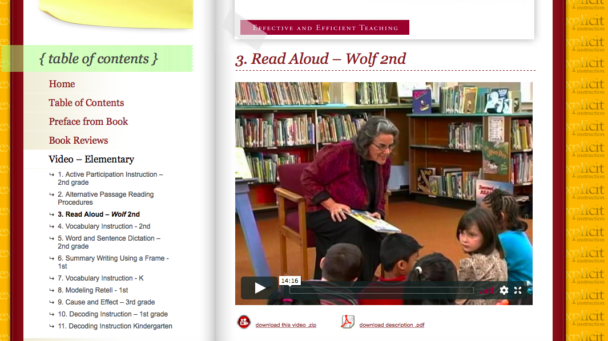


Watch, discuss, and analyze videos without Vosaic
Watch, discuss, and analyze videos without Vosaic

Slide 41
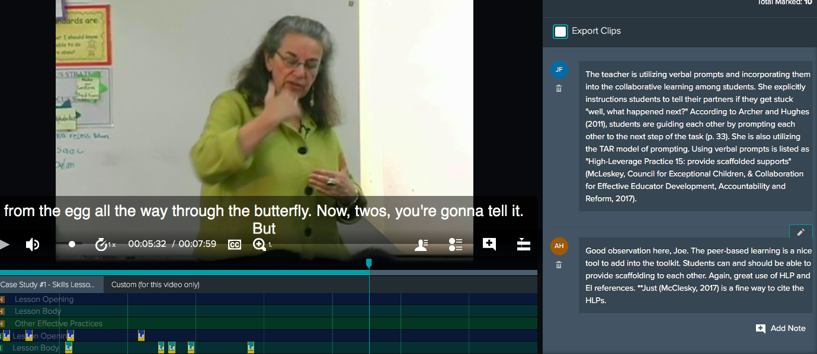
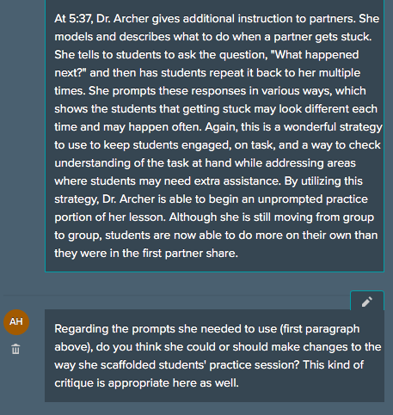
Describe and analyze videos with Vosaic
Describe and analyze videos with Vosaic

Slide 42
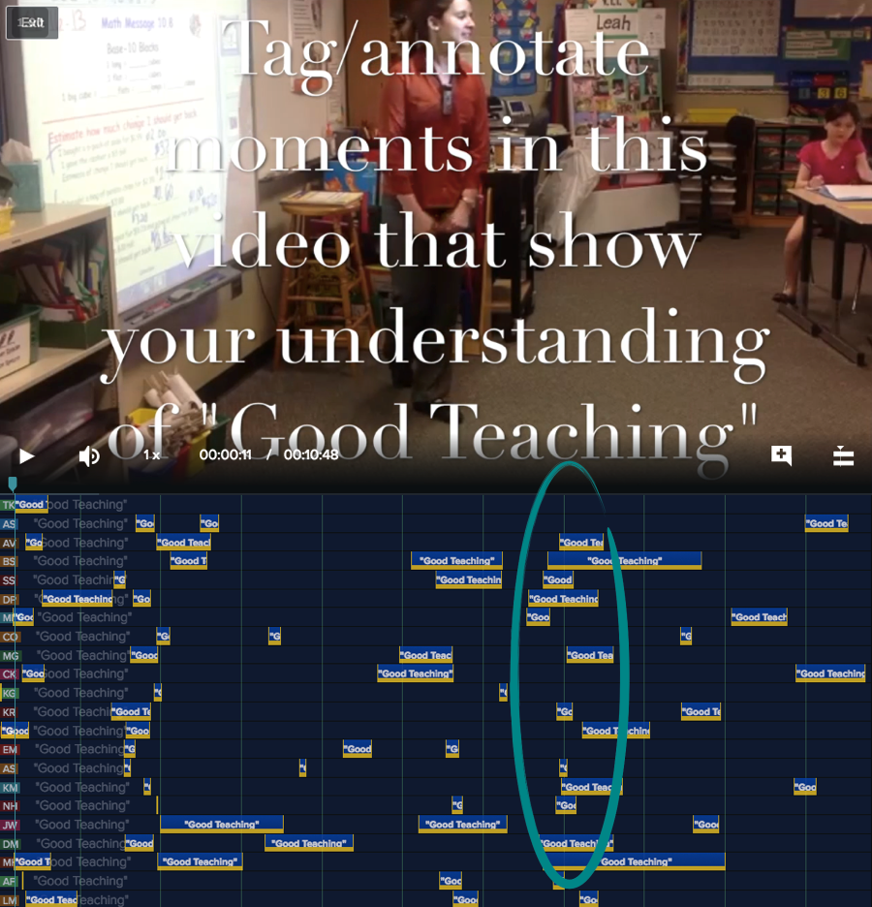

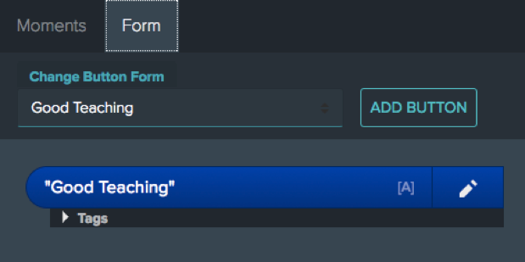
Vosaic Example 1
The teacher had their students discuss with a partner.
See It

Slide 43
Helping Candidates “Try it”
Addressing candidates’ fear of video
Small group teaching and co-planning of lessons
Providing clear goals for videotaped lessons
Fading feedback on lesson/script development
Emphasizing the importance of application with sufficient preparation

Slide 44
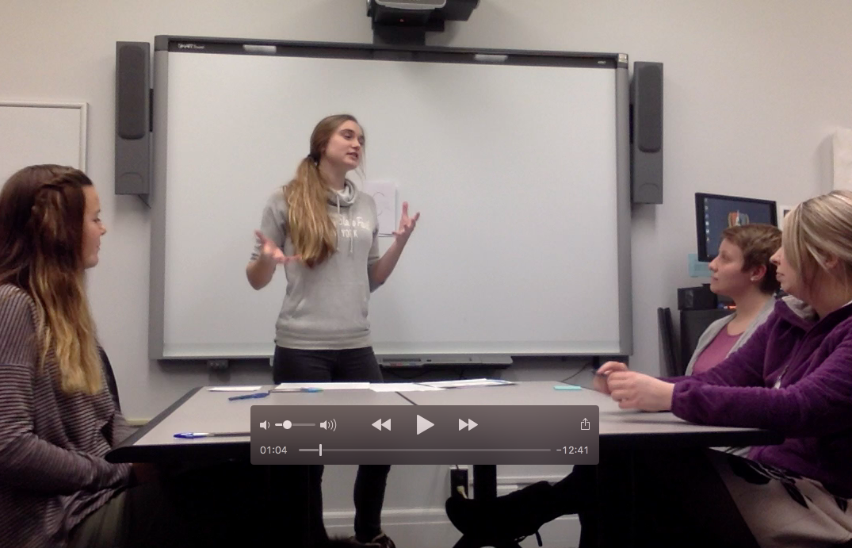
Small group teaching demo with peer debrief
Small group teaching demos with peer debrief

Slide 45

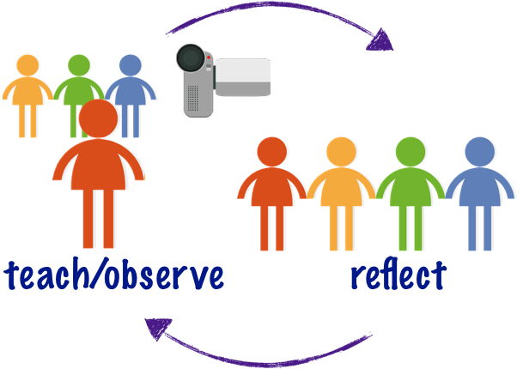

Research Lessons
Try It

Slide 46
Helping Candidates “Reflect on it”
Model reflection in our own college teaching
Emphasize growth
Provide assignment-specific reflective prompts
Balance “glows” and “grows”

Slide 47

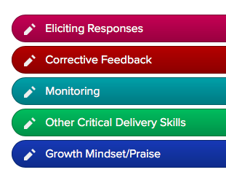
Vosaic Form
Feedback – When does the teacher use corrective feedback in this lesson? Was the corrective feedback delivered in ways supported by Archer and Hughes (2011)? What suggestions for improvement, if any, do you have?
Praise --When/where does the teacher deliver praise to students in this lesson? In what ways does the instructor’s use of praise support a growth mindset vs. fixed mindset (Dweck, 2008)? Can you identify any areas for improvement?

Slide 48
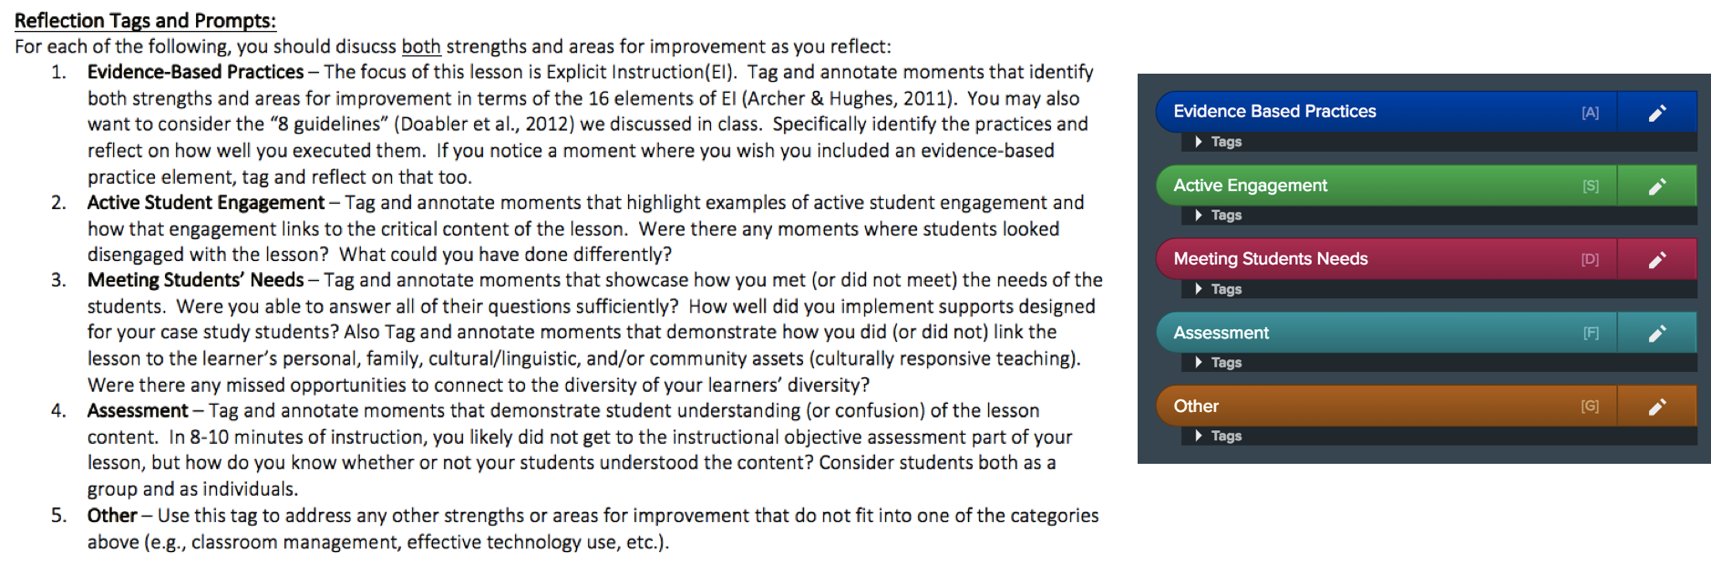
Students Tag and Annotate Videos with Their Reflections
Reflect
on It

Slide 49
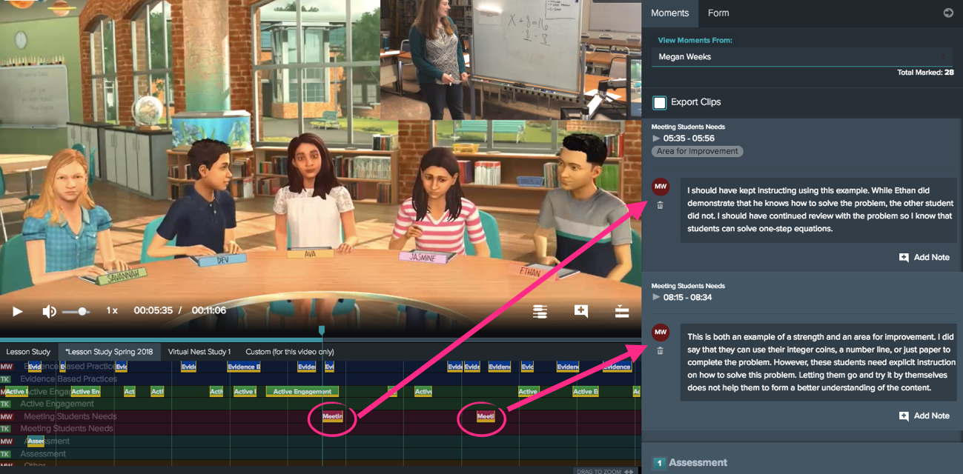
Vosaic Example 2
Students tag and annotate videos with their reflections
Reflect
on It

Slide 50

New Directions for Vosaic at Illinois State University
Fidelity of Implementation
Clinical observations
Faculty Mentorship Program

Slide 51
Survey Results (2018-2019)
Sample: 180 students who had used Vosaic in one or more college courses.
Response rate: 60% (n=118)
Survey: 5-point Likert scale with follow-up questions

Slide 52
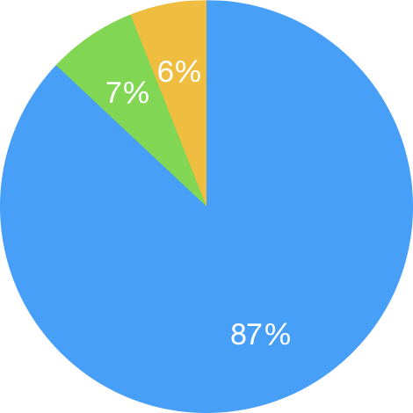
Survey Results (1)
Neutral
Disagree/
Somewhat Disagree
The Vosaic platform was easy to use for my reflection.
Agree

Slide 53
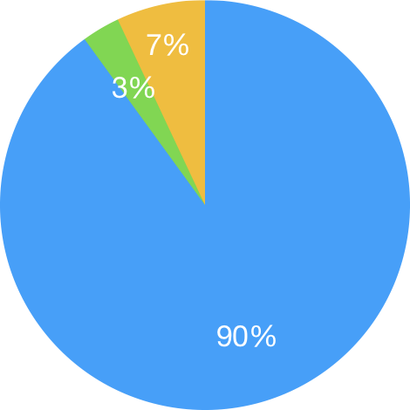
Survey Results (2)
Neutral
Disagree/Somewhat Disagree
The Vosaic platform helped me notice strengths/areas for improvement in my teaching.
Agree

Slide 54
Student Comments
I definitely prefer this method over having to write an essay because I can visually see what I'm doing and reflect on it as I am watching and see overall what are my strengths, what are my weaknesses, how can I improve, etc.
Vosaic made it easy to see strengths and weaknesses.
I enjoyed the tags on Vosaic. This is also great because it helps me practice for the edTPA in the future. I wish we could get more practice with it!

Slide 55
Guiding Questions for Faculty Considering VPF
How do we currently evaluate students on performance or skill-based outcomes?
What are the strengths of our approaches, and where are our opportunities for growth?
How does reflection currently play a role in student development of performance outcomes, and how do we scaffold this process for students?
Is reflection sufficiently detailed and tied to specific moments, or do students generally reflect on a more general or global level?
Would the ability to reflect on more specific moments provide the potential for more accurate demonstration of learning, and enhanced assessment?

Slide 56
Questions?

Slide 57
Final Considerations
Plan for the possibility of rapid transitions between instructional modes
Build flexibility into partnership agreements
Exercise creativity in providing candidates with practice-based opportunities

Slide 58
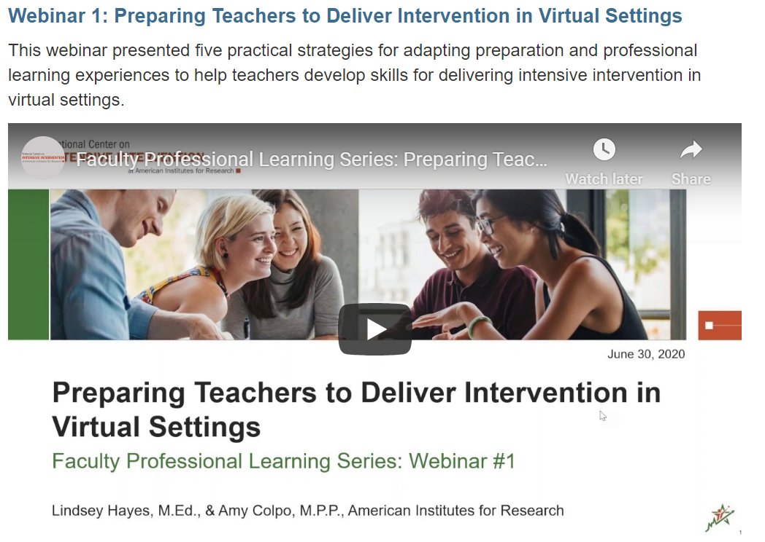
Faculty Learning Series Webpage
Access recordings, transcripts, and slide decks from past webinars at https://intensiveintervention.org/resource/faculty-professional-learning-series-intensive-intervention
Materials from today’s webinar will be posted shortly

Slide 59
Upcoming Webinars
Webinar #3: Course Content Resources for Intensive Intervention
  October 7, 2020 from 3:00-4:00pm ET
Webinar #4: Continuous Program Improvement
  December 1, 2020 from 3:00-4:00pm ET

Slide 60
Questions or COmments
Lindsey Hayes: lhayes@air.org
Amy Colpo: acolpo@air.org
Tara Kaczorowski: tlkaczo@ilstu.edu

Slide 61
References
Benedict, A., Holdheide, L., Brownell, M., & Foley, A. M. (2016). Learning to teach: Practice-based preparation in teacher education. Retrieved from https://ceedar.education.ufl.edu/wp-content/uploads/2016/07/Learning_To_Teach.pdf
Fuchs, D., Fuchs, L. S., & Vaughn, S. (2014). What is intensive instruction and why is it important? Teaching Exceptional Children, 46(4), 13-18.
Groves, S., Doig, B., Widjaja, W., Garner, D., & Palmer, K. (2013). Implementing Japanese lesson study: An example of teacher-researcher collaboration. Australian Mathematics Teacher, 69(3), 10-17.
Kretlow, A. G., & Bartholomew, C. C. (2010). Using coaching to improve the fidelity of evidence-based practices: A review of studies. Teacher Education and Special Education, 33(4), 279-299.
Mason-Williams, L., Rosenberg, M., Kimmel, L., & Sindelar, P. (2020). Addressing shortages of educators in an uncertain COVID-19 landscape: Viewing teacher candidates as assets. Retrieved from https://ceedar.education.ufl.edu/wp-content/uploads/2020/06/Addressing-Shortages-COVID-Landscape.pdf
Switzer, J. M., Teuscher, D., & Siebert, D. (2015). See it, try it, and reflect on it (STaR): Using video to scaffold and support preservice teachers in the reflective process of developing participation questioning discourse. In E. Ortlieb, L. E. Shanahan, & M. B. McVee (Eds.), Video research in disciplinary literacies (Literacy research, practice and evaluation, Volume 6) (pp. 3–20). Emerald Group Publishing Limited.

Slide 62
NCII Disclaimer
This presentation was produced under the U.S. Department of Education, Office of Special Education Programs, Award No. H326Q160001. Celia Rosenquist serves as the project officer. The views expressed herein do not necessarily represent the positions or policies of the U.S. Department of Education. No official endorsement by the U.S. Department of Education of any product, commodity, service, or enterprise mentioned in this presentation is intended or should be inferred

